Slide 1
Apache Spark Workshop
WIT NYC Hour of Code | 7 Dec 2017
Notes:
Jenny

Slide 2
Welcome!
Today’s Agenda
What is distributed computing?
What is Spark and why does it matter?
What is Databricks?
Hands-on Tutorial using Spark on Databricks
Notes:
Jenny

Slide 3
What is distributed computing?
Computing across clusters
Scalable, fault-tolerant
Foundation of Hadoop

Slide 4
What is Spark and why is it important?
Cluster computing framework for big data processing
Spark APIs to code in Python (PySpark), R, Java, Scala
SparkSQL for relational data querying
MLlib for machine learning
GraphX for graph processing
Notes:
Keira
SparkSQL:
- Spark's module for working with structured data
- Can write native SQL queries. Maybe more intuitive to use
MLlib: Machine learning library – SVM, Logistic regressions, Random forest, etc.
GraphX: PageRank, Triangle count, etc.

Slide 5
What is MapReduce?

Slide 6
Spark versus Hadoop MapReduce
Spark can be 100x faster than MR due to in-memory procesing (contrast with MR storing to disk)
Map-reduce concepts still exist in Spark!
Notes:
Jenny

Slide 7
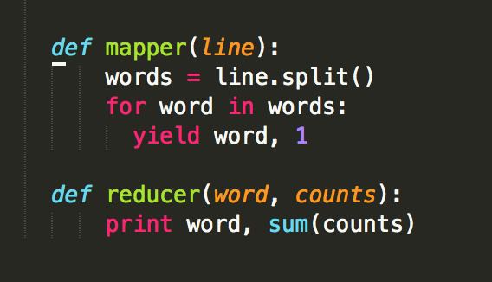
Counting in MapReduce
Notes:
Keira –
Map: Go through all data and return a (key, value) pair.
Reduce: Performs on the same key (group the same word together and count the total)
Difference: * map: One element in A is transformed to one element. One -> one. Size of B = size of A. * flatMap: One element in A is transformed to 0 or more elements, then the elements are connected together. One -> many. Size of B >= size of A. Shape of the transformation function: * map: One element in -> one element out. * flatMap: One element in -> 0 or more elements out (a collection).

Slide 8
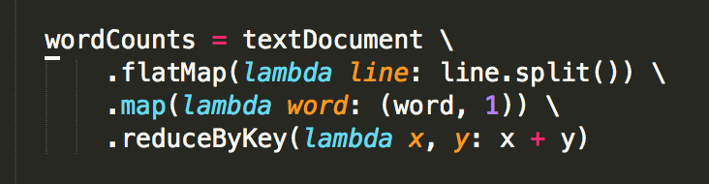
Counting in Spark
Notes:
Keira

Slide 9
Some deeper Spark concepts…
Spark 1.x
Spark Context (SC): must be created at the start of Spark session
Resilient Distributed Dataset (RDD): data across cluster nodes that can be acted on in parallel
new RDDs are created lazily with each transformation, such as map, reduceByKey, etc
can be converted to/from Spark’s relational DataFrames
SQL Context: created from SC and provides RDMS operations
Spark 2.x
SparkSession: A unified entry point for manipulating data with Spark
Notes:
Keira –
Spark Context: Like an entry point for all Spark Functionality
(Spark is built on top of) Resilient Distributed Datasets (RDD): is a fundamental data structure of Spark. It is an immutable distributed collection of objects. Each dataset in RDD is divided into logical partitions, which may be computed on different nodes of the cluster. RDDs can contain any type of Python, Java, or Scala objects, including user-defined classes.
For Spark 2.x, all contexts are combined into one called SparkSession. Won’t go into details here.

Slide 10
Some deeper Spark concepts (con’t)
Transformation
Operations that will not be completed at the time you write and execute the code in a cell
They will only get executed once you have called a action
Example: select, sum, filter
Action
Operations that are computed by Spark right at the time of their execution
They consist of running all of the previous transformations in order to get back an actual result
Example: show, count, save
Notes:
There two types of operations in Spark: Transformation and Action
The reason for this is that it gives a simple way to optimize the entire pipeline of computations as opposed to the individual pieces. This makes it exceptionally fast for certain types of computation because it can perform all relevant computations at once.

Slide 11
What is Databricks
Databricks is a managed platform for running Apache Spark
No need to manage complex cluster
Spark was originally written by the founders of Databricks during their time at UC Berkeley
The community version provides the Workspace with a free mini 6GB cluster
Notes:
Usually in order to run Spark, you will create your own cluster with Spark installed. The difficult part is you will need to maintain the cluster yourself.
Databricks manages everything for you.

Slide 12
Hands-on Tutorial: ”Hello, Spark!”
Take out your laptops (and/or share with a neighbor!)
Head to: https://community.cloud.databricks.com/
Register an account
Import the notebook
The Lab: http://bit.ly/2BaX4f0
The Solutions: http://bit.ly/2B5NI44
Click on “Import Notebook” on the top right corner
Questions? Let us know!
Notes:
Lab:
http://bit.ly/2BaX4f0
https://databricks-prod-cloudfront.cloud.databricks.com/public/4027ec902e239c93eaaa8714f173bcfc/4443195121429830/4308183828828099/7207115438378300/latest.html
Answer:
http://bit.ly/2B5NI44:
https://databricks-prod-cloudfront.cloud.databricks.com/public/4027ec902e239c93eaaa8714f173bcfc/4443195121429830/2875891994290839/7207115438378300/latest.html

